Slide 1
K-Means Parallelization
Blake Davis, Chris LaBerge, and Tyson O’Leary

Slide 2
What is our project? Parallelized Code
K-Means Clustering is an algorithm that aims to cluster data points into groups
Machine Learning algorithms are often slow as they often use large amounts of data.
The code we used is from the Department of Electrical and Computer Engineering at Northwestern University by Wei-king Liao.
Sequential Program
137 lines of code
Execution in 16.20 seconds at 13.22 GFLOPS*
Given OMP Program
251 lines of code
Execution in 2.78 seconds at 76.97 GFLOPS*
*With 29,400 data points, 9 dimensions, and 5000 cluster centers
Notes:
The sequential code was 137 lines of code and the given OMP code was 251 lines of code
The initial time of the Sequential Code with 29,400 data points and 5000 cluster centers was 16.20 seconds with 13.22 GFLOPS
The initial time of the given OMP Code with 29,400 data points and 5000 cluster centers was 2.78 seconds with 76.97 GFLOPS

Slide 3
Details of Work: What We Did
CUDA proved to be difficult. Decided to pivot to improving the given OMP code.
To Improve the OMP version:
Swapped the loops that looped through each dimension and each cluster with the goal to vectorize loop operations
In order for our program to have vectorized loops, we had to transpose the matrix that stores the locations of our cluster centers.
If we did not transpose the matrix, the memory accesses would not be adjacent. This would prevent the vectorization of our loops.

Slide 4
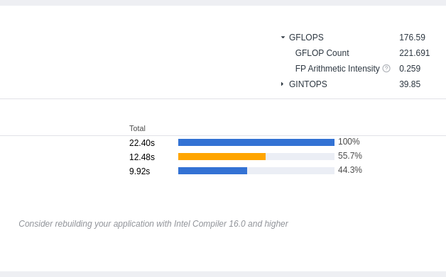
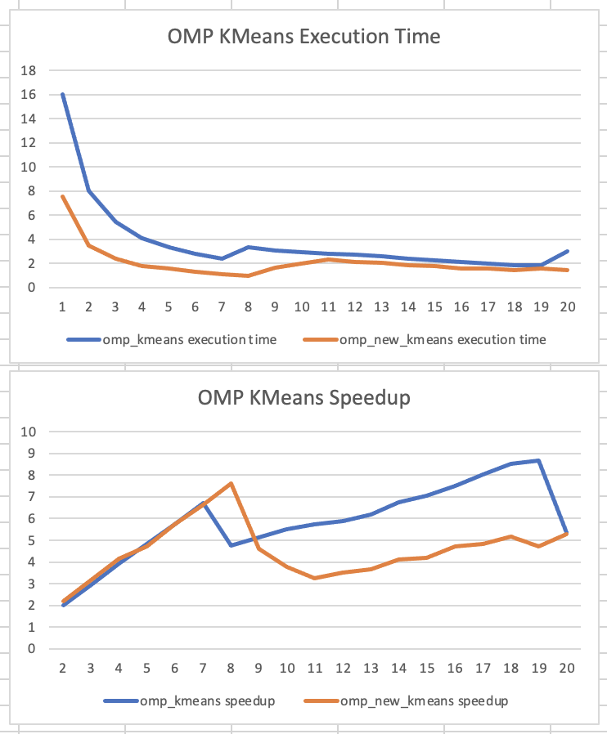
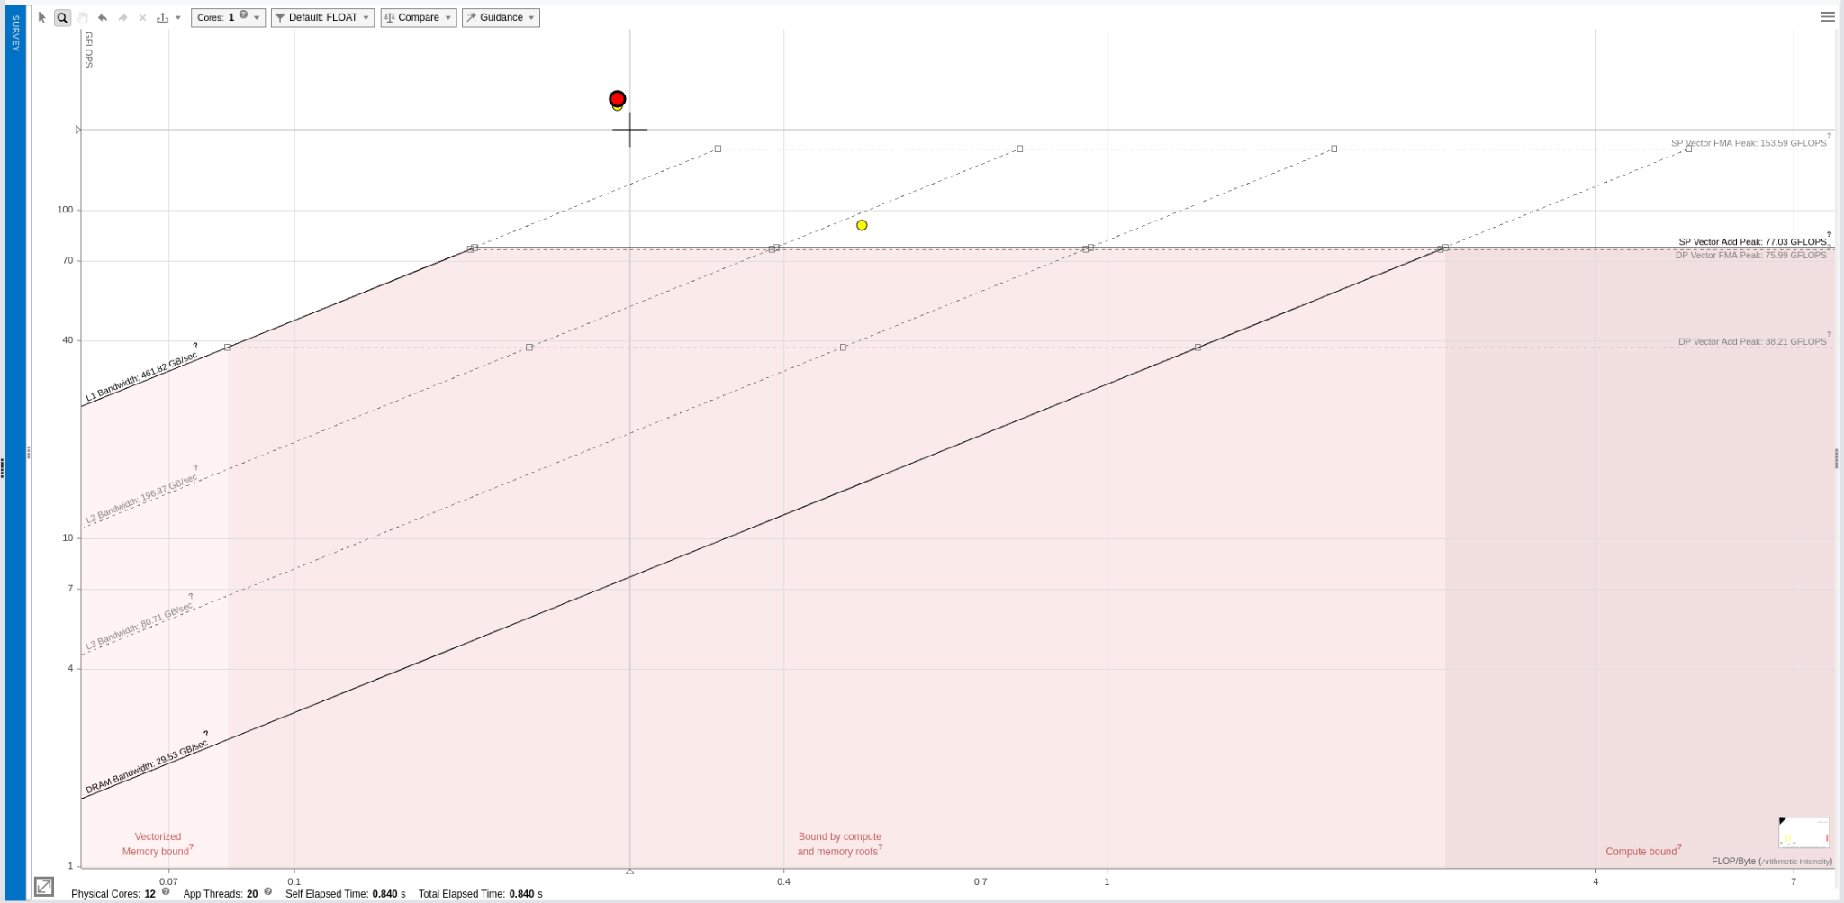
Details of Work: Results

Slide 5
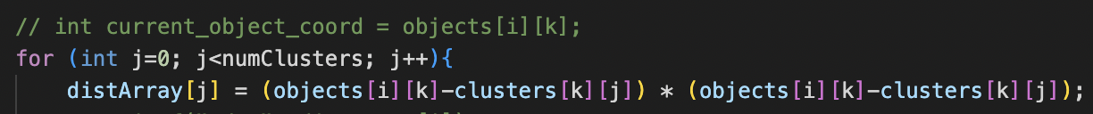
Conclusions and Lessons
Vectorization
Vectorizing a loop requires that all operations done within the innermost loop are vectorizable and that all memory accesses are adjacent. Also requires the ICC compiler
Cache Locality
A result of adjacent memory accesses also means better cache locality
Further improvement could be using blocking
Debugging
Parallel debugging skills improved
Cannot use valgrind, so had to devise our own method. Using print statements to isolate behavior
Hail Mary
Creating a variable to store duplicate memory accesses did not work
Sanjay for the win 🎉

